Slide 1
Section-4 – Personalized Marketing
Chapter 7-Exploratory Analysis for Customer Behavior

Slide 2
Section-4 – Personalized Marketing
In this section, learn how to use data to understand customer behavior better
How to use machine learning to predict the likelihood of marketing engagement and the value of individual customers over their lifetime
How to use data science for better customer retention.
This section consists of the following chapters:
Chapter 7, Exploratory Analysis for Customer Behavior
Chapter 8, Predicting the Likelihood of Marketing Engagement
Chapter 9, Customer Lifetime Value• Chapter 10, Data-Driven Customer Segmentation
Chapter 11, Retaining Customers

Slide 3
Introduction
In this chapter, discuss what customer analytics is, the importance and benefits of analyzing and having a better understanding of the customer base, and the use cases of customer analytics in different aspects of marketing.
Gather and track more data on customers and their behavior regarding individual sales, marketing platforms, and channels, it becomes easier for marketers to analyze and understand how different customers react to different marketing strategies.
Customer analytics helps marketers understand their customers better by utilizing this data.
Furthermore, it can help marketers to form better marketing strategies that can improve engagement, retention, and conversion rates.
In this chapter, cover the following topics:
Customer analytics: understanding customer behavior
Conducting customer analytics with Python
Conducting customer analytics with R

Slide 4
Customer Analytics - Understanding Customer Behavior
Customer analytics is a process of understanding and gaining insights into customer behavior through analyzing customer behavior data.
It ranges from simple data analysis and visualization to more advanced customer segmentation and predictive analytics.
The information and insights gained through customer analytics can then be utilized in forming marketing strategies, optimizing sales channels, and making other key business decisions.
The importance of customer analytics is rising.
Because access to customer data has become easier for many businesses
Also because customers now have easier access to data and information on similar products and contents provided by other competitors, it is critical for many businesses to be able to understand and predict what their customers are likely to purchase or view.
The deeper the understanding you have about your customers, the better competitive power you will have against your competitors.

Slide 5
Customer analytics use cases
Customer analytics can be used at any point in the marketing process.
It can be used to monitor and track how customers interact with the products or react to different marketing Strategies.
This typically requires using data analysis and visualization techniques to build reports or dashboards that can easily show key performance indicators (KPIs).

Slide 6
Sales funnel analytics
One of the common use cases of customer analytics is sales funnel analytics.
By analyzing sales funnel data, can monitor and track the life cycle of customers, gaining insights such as through which marketing channel they sign up, how often they log into the system, what types of products they browsed and purchased, or how they fall off from each step of the funnel.

Slide 7
Customer segmentation
Customer analytics can also be used to identify different groups of customers based on their behavior.
Customer segmentation is a good example and outcome of customer analytics.
By identifying subgroups of similar customers, can better understand the target populations.
For example, the marketing strategy for low-engagement customers should be different from the marketing strategy for high-engagement customers.
By effectively segmenting the customer base by the level of engagement, can have a deeper understanding of how different groups of customers behave and react to different marketing strategies.
This further helps for better target certain subgroups of customers.

Slide 8
Predictive analytics
Another good use case of customer analytics is using predictive analytics on customer data.
With customer data, can have a deeper understanding of what attributes and characteristics of customers are highly correlated with the outcomes of our interest.
For example, if we would like to improve the response and engagement rates, analyze the data to identify those characteristics of customers that result in higher responses and engagement rates.
Then, build predictive models that predict how likely it is that our customers are going to respond to our marketing messages.
Another example of the usage of predictive analytics can be for marketing channel optimization.
With the insights gained from customer analytics, build predictive models to optimize marketing channels.
The customers are going to respond differently to different marketing channels.

Slide 9
Predictive analytics
For instance, younger cohorts, who use smartphones more heavily than the rest of the population, are more likely to respond to marketing via smartphones.
On the other hand, more senior cohorts are more likely to respond better to marketing on more traditional media, such as TV or newspaper advertisements.
With customer analytics, identify correlations between certain attributes of customers and the performances of different marketing channels.
As discussed, The applications of customer analytics are broad and can be used at any point of the marketing process.
In the following programming exercises, discuss how can use customer analytics to monitor and track different marketing strategies and see some of the ways to segment and analyze the customer base to gain insights.
Then, in the following chapters, explore other use cases of customer analytics, such as optimizing engagement and retention rates, and customer segmentation.

Slide 10
Conducting customer analytics with Python
In this section, discuss how to conduct customer analytics using Python.
Use the pandas and matplotlib packages to analyze and visualize the customer behavior observed in the dataset.
For this exercise, use one of the publicly available datasets from IBM, which can be found at this link:
https:// www.ibm.com/communities/analytics/watson-analytics-b1og/marketing-customer-value-analysis/.
From the link download the data that is available in CSV format, named WA Fn UseC_ Marketing Customer Value Analysis. csv.
After download the data, load it into Jupyter Notebook by running the following command:
import pandas as pd
df = pd.read_csv ('../data/WA_Fn-UseC_-Marketing-Customer-Value-Analysis. csv')

Slide 11
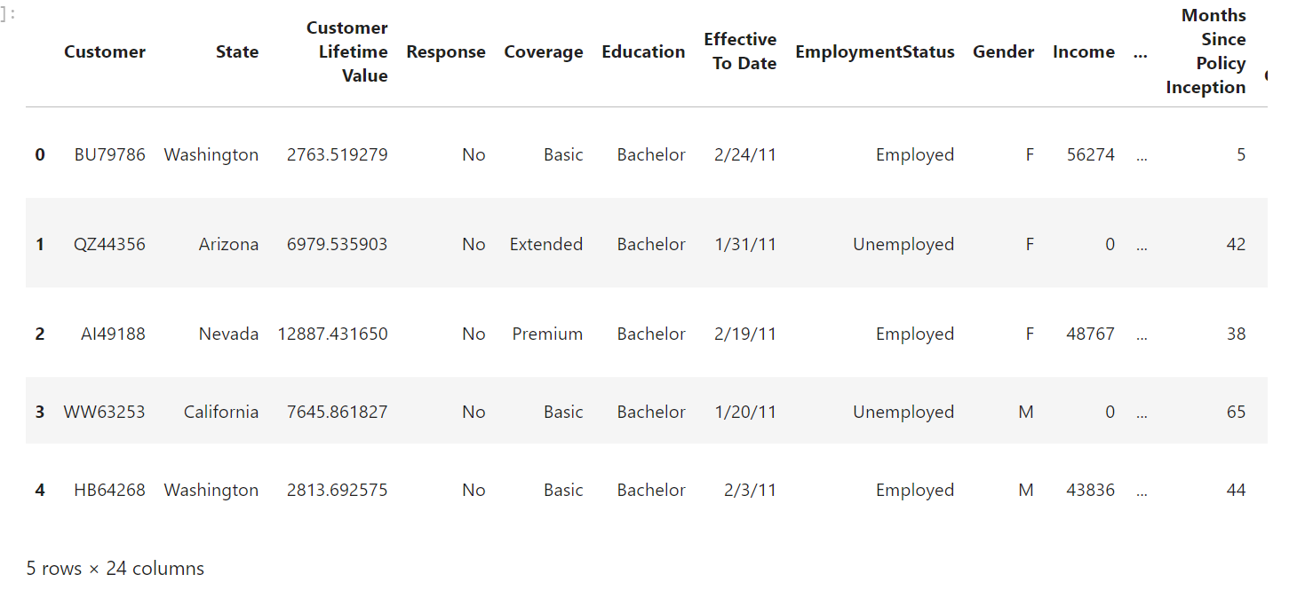
Conducting customer analytics with Python
Once load this data is into a pandas DataFrame, it should look as follows:

Slide 12
Conducting customer analytics with Python
As from this data, there is a column named Response, which contains information about whether a customer responded to the marketing efforts.
Also, the Renew Offer Type and Sales Channel columns represent the type of renewal offer presented to the customer and which sales channel was used to contact the customer.
Numerous other columns represent the socio-economic backgrounds of the customers and the types of insurance coverage that the customers currently have.
Utilizing this information to analyze and understand customer behavior better, especially in regards to their responses and engagement with the marketing and sales efforts.

Slide 13
Analytics on engaged customers
After loading the data into Python environment, analyze it to understand how different customers behave and react to different marketing strategies.
Follow these steps:
1. Overall engagement rate
2. Engagement rates by offer type
3. Engagement rates by offer type and vehicle class
4. Engagement rates by sales channel
5. Engagement rates by sales channel and vehicle size

Slide 14
Overall engagement rate
Use the following code to get the total number of customers who have responded:
df. groupby ('Response'). count () ['Customer’]
From the data, the Response column contains information about whether a customer responded to the marketing call or not (Yes for those who have responded and No for those who have not).
Grouping by this column by using the groupby function in a pandas DataFrame and counting the number of customers in each category with the count function in the pandas package.

Slide 15
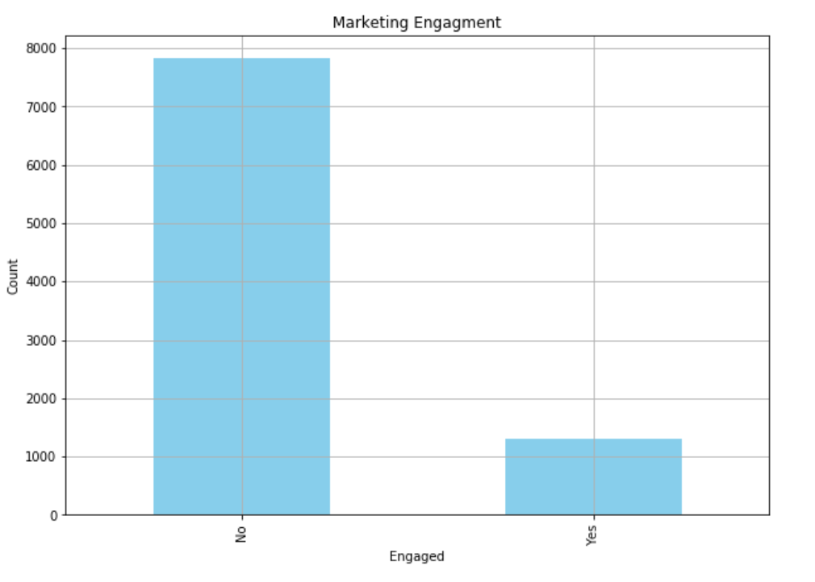
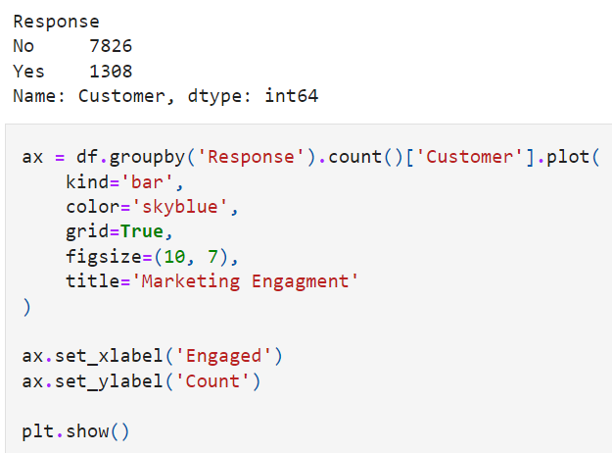
Visualization

Slide 16
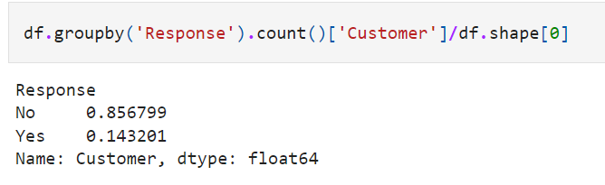
Overall engagement rate
From the result the majority of customers did not respond to the marketing calls.
Find the result in terms of percentage by using the following code
From the result, only 14% of the customers responded to the marketing calls

Slide 17
Engagement rates by offer type
Different types of offers will work differently for the customers.
In this section, check what types of offers worked best for the engaged customers.
Take a look at the following code:
by_offer_type_df = df.loc[df ['Response'] == 'Yes']. groupby (I'Renew Offer Type'1). count ()['Customer'] / df. groupby ('Renew Offer Type'). count () ['Customer']

Slide 18
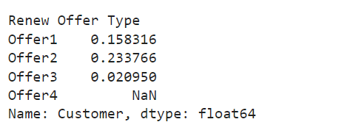
Engagement rates by offer type
From this code, grouping by the Renew Offer Type column, where we have four different types of offers.
Count the number of engaged customers for each type of these renewal offers first by filtering for those with Yes values in the Response column.
Then, divide these numbers by the total number of customers in each renewal offer type to get the engagement rates per renewal offer type.
The result looks as follows:

Slide 19
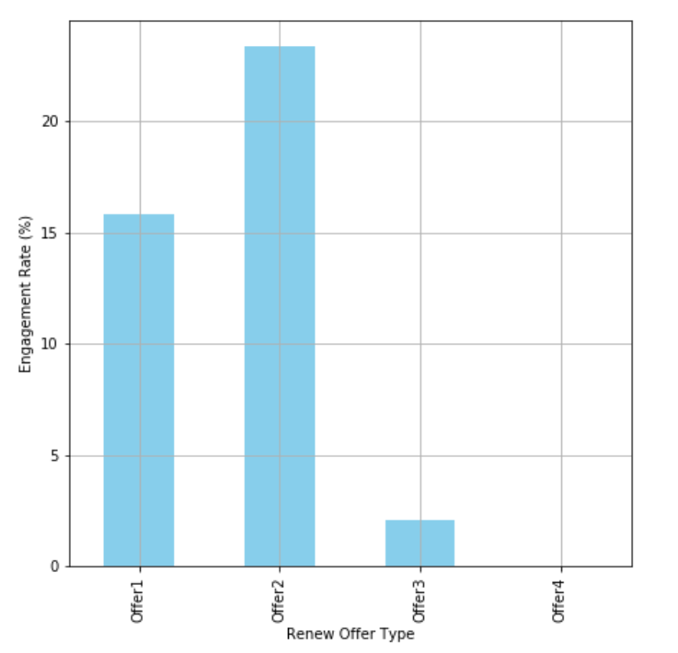
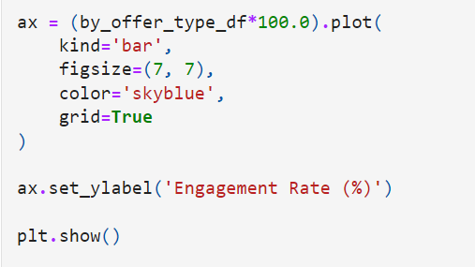
Visualization

Slide 20
Visualization
Easily notice from the above plot, Offer2 had the highest engagement rate among the customers.
When conducting customer analytics, as discussed earlier, we often want to know the demographics and attributes of customers for each event, so that we can understand what works best for which type of customers.
This can lead to further improvements in the next marketing campaign by better targeting those subgroups of customers.
Let's take a step further into this data.

Slide 21
Engagement rates by offer type and vehicle class
In the previous section, learned that Renewal Offer Type 2 worked best for the customers.
The marketers can benefit from this information itself, as this finding provides a useful insight into which type of offer worked best and had the highest response rate from customers.
However, gain more insights on how different customers with different backgrounds or characteristics react differently to each offer type.
In this section, analyze what you can do as a marketer to understand how customers with different attributes respond differently to different marketing messages.

Slide 22
Engagement rates by offer type and vehicle class
Let's see whether there is any noticeable difference in the response rates for each offer type for customers with different vehicle classes.
Look at the engagement rates by each offer type and Vehicle Class using the following code:
by_offer_type_df = df.loc[df ['Response'] == 'Yes'] • groupby ( ['Renew Offer Type', 'Vehicle Class'1). count () ['Customer']/df. groupby ('Renew Offer Type'). count () ['Customer’]
As you can see from this code, we are grouping the data by two columns, Renew Offer Type and Vehicle Class, and computing the engagement rates for each group.The result looks as follows:

Slide 23
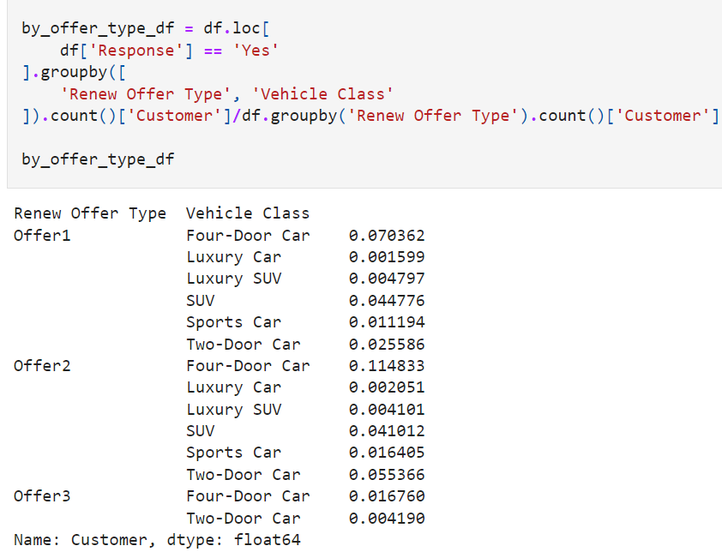
Engagement rates by offer type and vehicle class

Slide 24
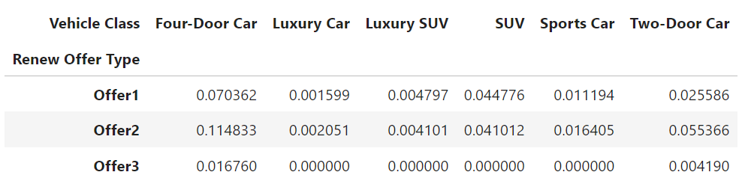
Engagement rates by offer type and vehicle class
To make this more readable, transform this data by using the following code:
by_offer_type_df = by_offer_type_df. unstack () .fillna (0)
Use the unstack function in a pandas DataFrame to pivot the data and extract and transform the inner-level group to columns.
It will be easier to look at the result.
The result looks as in the following:

Slide 25
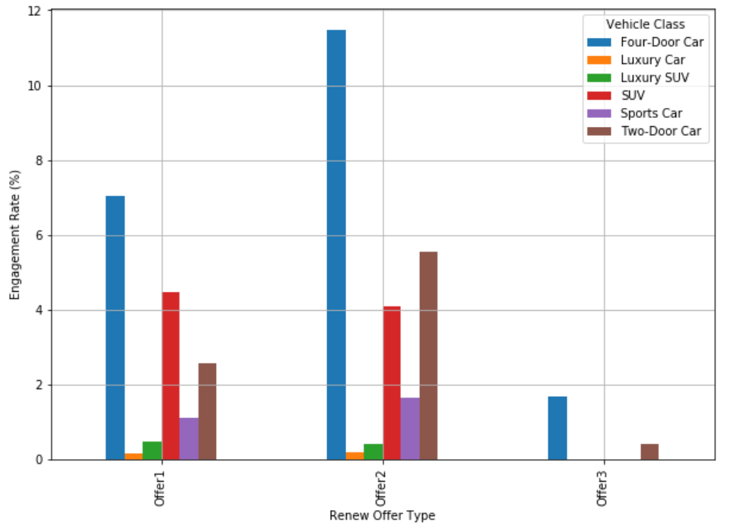
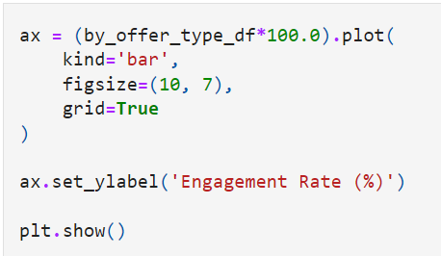
Visualization

Slide 26
Visualization
Let's take a closer look at this chart.
Offer2 had the highest response rate among the customers in the previous section.
Here, how customers with different vehicle classes engage differently with other types of renewal offers.
For example, customers with Four-Door Car respond the most frequently for all offer types.
However, customers with SUVs respond with a higher chance to Offer1 than to Offer2.
From these results, gain more insights by breaking down the customer demographics further.
If we see any significant difference in the response rates among different customer segments, we can fine-tune who to target for different sets of offers.
In our example, if we believe customers with SUV respond to Offer1 with a significantly higher degree of engagement than to Offer2, then target SUV customers with Offer1.
On the other hand, if we believe customers with Two-Door Car respond to Offer2 with a significantly higher degree of engagement than to other offer types, then target Two-Door Car owners with Offer2.

Slide 27
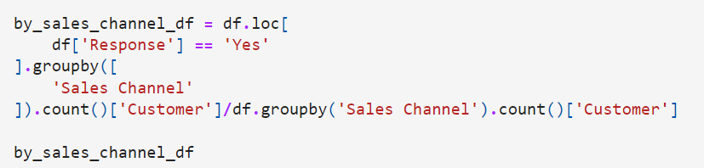
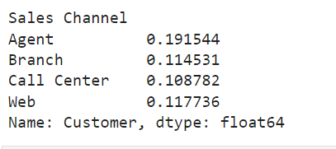
Engagement rates by Sales Channel
With another example, analyze how engagement rate differ by different sales channels with the following code:
The result looks as follows:

Slide 28
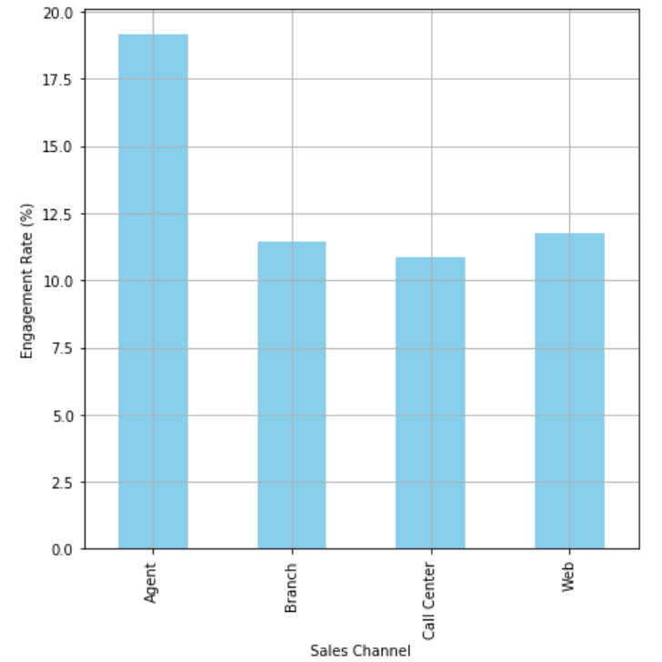
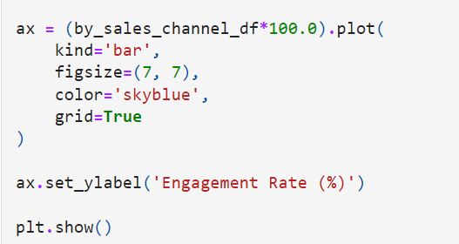
Engagement rates by Sales Channel
From the plot, Agent works the best in terms of getting responses from the customers.
Then sales through Web works the second best.
As before, break down this result deeper and analyze it to see whether the behavior changes among customers with different characteristics

Slide 29
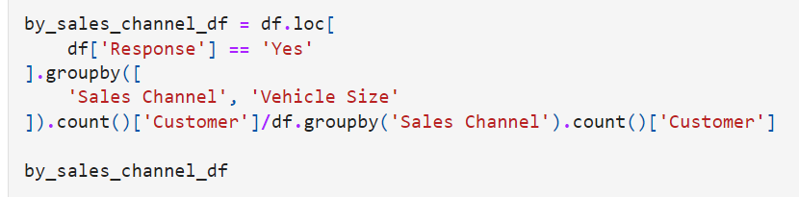
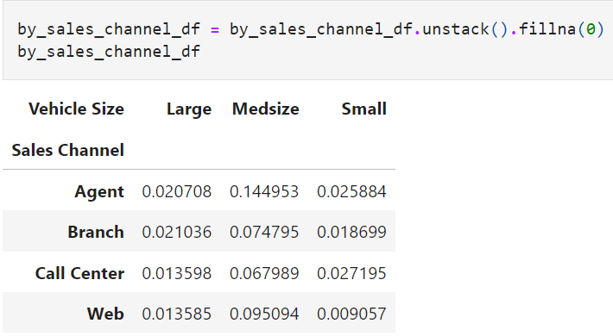
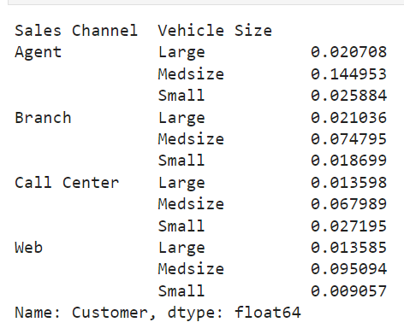
Engagement rates by Sales Channel & Vehicle Size
In this section, look at whether customers with various vehicle sizes respond differently to different sales channels
With the following code, compute the engagement rate per sales channel and vehicle size
The result looks as follows:

Slide 30
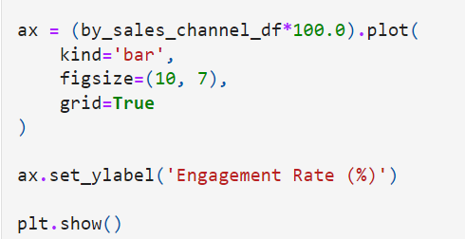
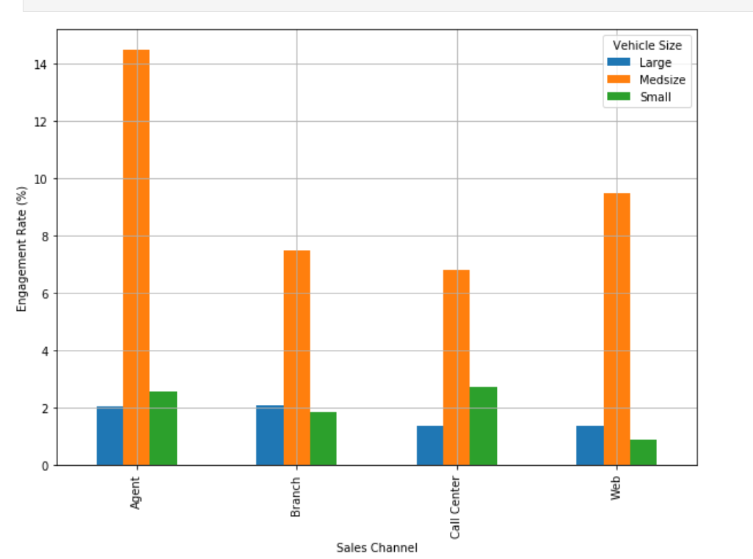
Engagement rates by Sales Channel & Vehicle Size

Slide 31
Engagement rates by Sales Channel & Vehicle Size
From this plot, customers with Medsize vehicles respond the best to all sales channels.
The engagement rates across different sales channels differ slightly between Large and Small vehicle owners.
For example, Smal1 vehicle owners respond better through Agent and Call Center channels, while on the other hand, Large vehicle owners respond better through the Branch and Web channels.
As discussed previously, utilize this insight in the next marketing efforts.
For example, as Small car owners respond with a higher chance through Agent and Call Center, utilize those two channels more heavily for Small car owners.

Slide 32
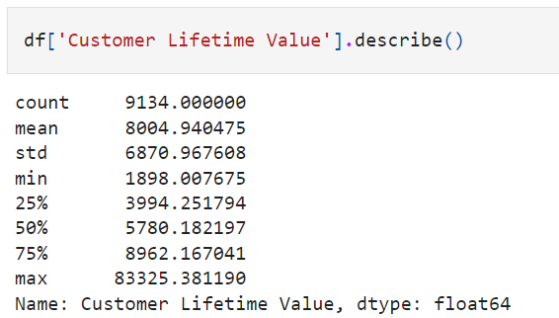
Segmenting customer base
In this section, going to discuss how we can segment the customer base.
Segmenting our customer base by Customer Lifetime Value and Months since Policy Inception.
Feel free to try different features for segmenting the customer base.
Take a look at the following distribution of the Customer Lifetime Value column:

Slide 33
Segmenting customer base
Based on this information, define those customers with a Customer Lifetime Value higher than the median as high-CLV customers and those with a CLV below the median as low-CLV customers.
Use the following code for encoding:
d['CLV Segment'] = df l'Customer Lifetime Value'] apply (lambda x: 'High' if x > df['Customer Lifetime Value']. median () else'Low’
Go through the same process for the Months Since Policy Inception field.
Take a look at the following distribution for Months Since Policy Inception:

Slide 34
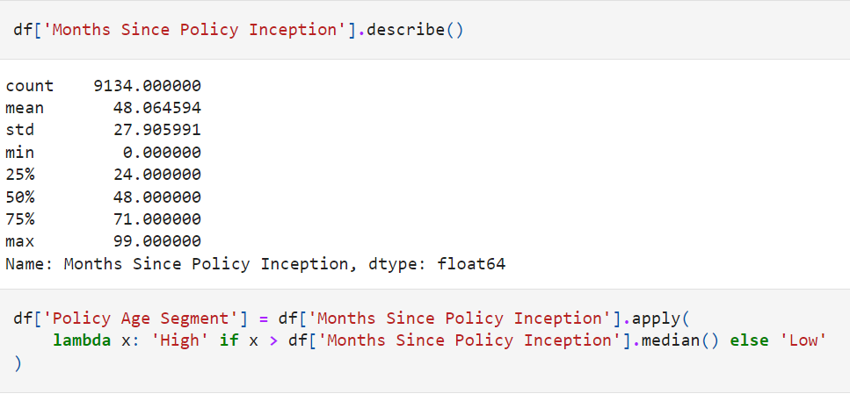
Segmenting customer base

Slide 35
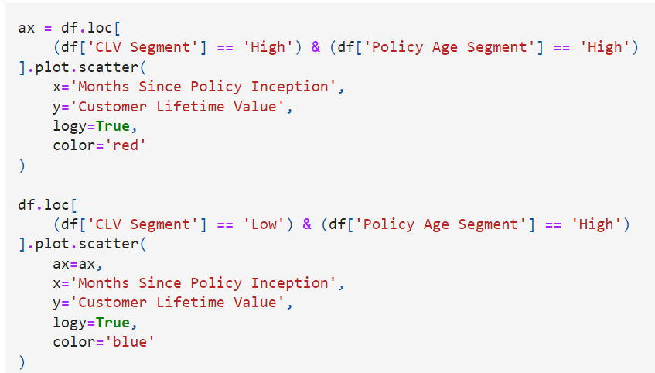
Visualize the segments

Slide 36
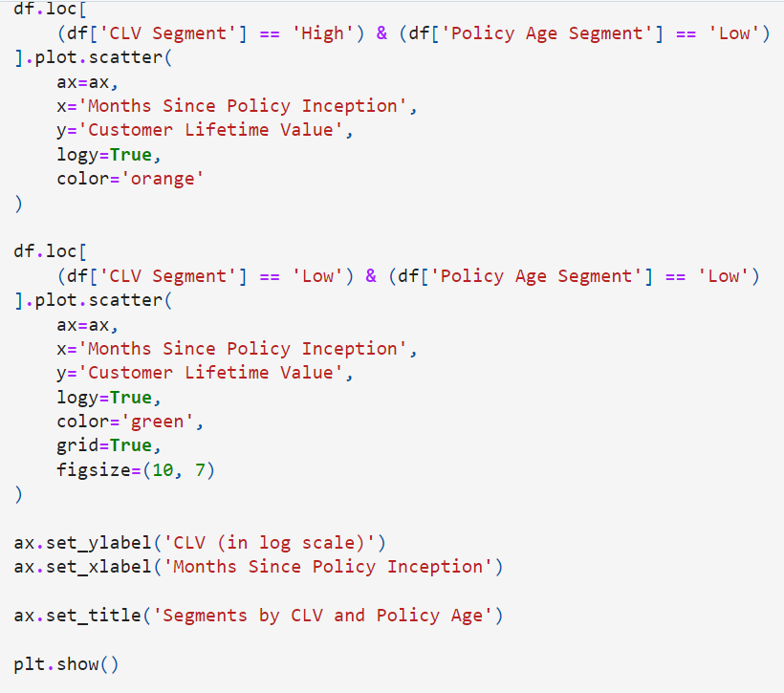
Visualize the segments

Slide 37
Visualize the segments
In the first code block, creating a scatter plot using the plot.
scatter function in the pandas package for those customers in the High CIvand High Policy Age segments.
By using the logy-True flag, easily transform the scale to log scale.
Log scale is often used for monetary values, as they often have high skewness in their values.
We repeat this process four times for the four segments that have been created previously.

Slide 38
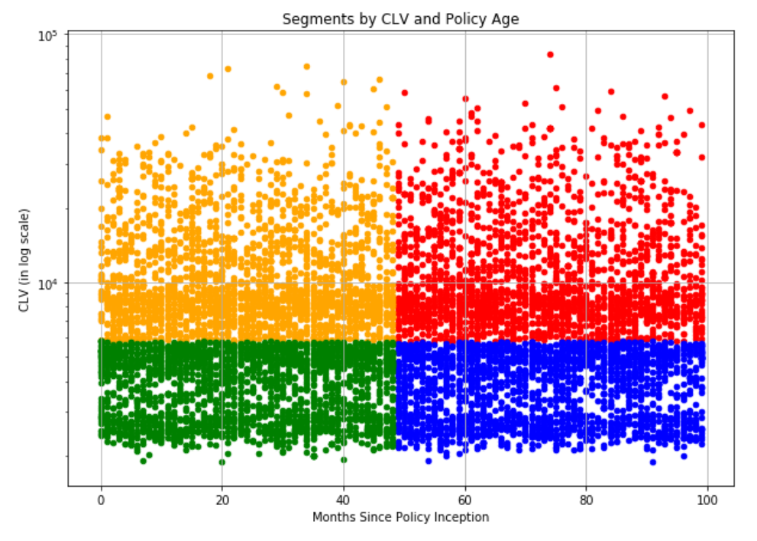
Visualize the segments
The resulting scatter plot looks as follows:

Slide 39
Visualize the segments
From this scatter plot, the data points in red represent those customers in the High CLV and High Policy Age segment.
Those in orange represent the High CIV and How Policy Age group, those in blue represent the Low CIV and High Policy Age group, and lastly, those in green represent the Low CIV and Low Policy Age group.
Now let's see whether there is any noticeable difference in the engagement rates among these four segments.
Take a look at the following code:

Slide 40
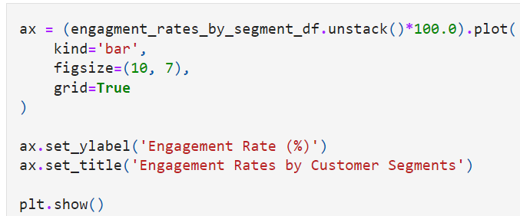
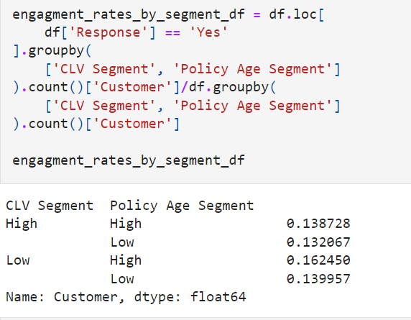
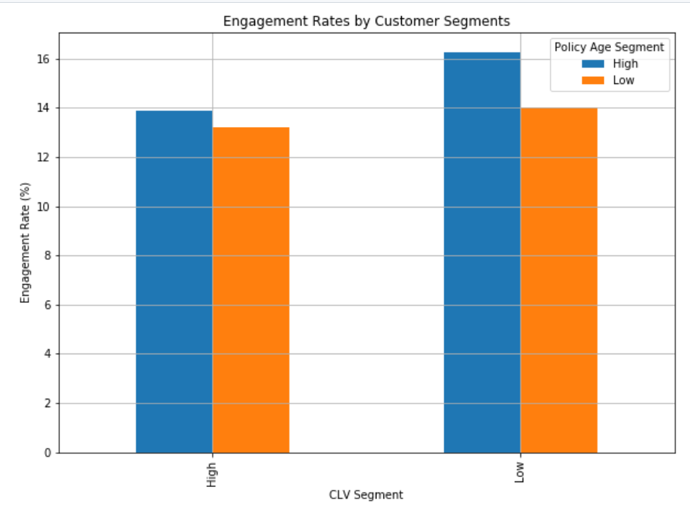
Visualize the segments

Slide 41
Visualize the segments
From the above plot, High Policy Age Segment has higher engagement than the Low Policy Age Segment.
This suggests that those customers who have been insured by this company longer respond better.
It is also noticeable that the High Policy Age and Low CLV segments have the highest engagement rate among the four segments.
By creating different customer segments based on customer attributes, we can better understand how different groups of customers behave differently.
We are going to further expand and experiment the concept of customer segmentation in more depth in Chapter 9

Slide 42
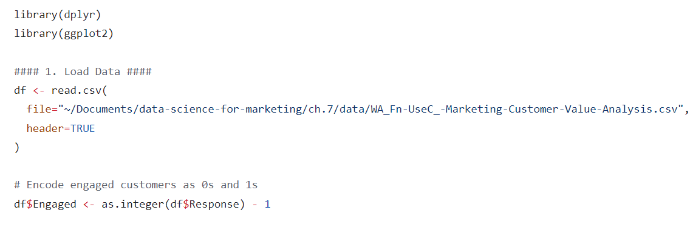
Conducting customer analytics with R

Slide 43
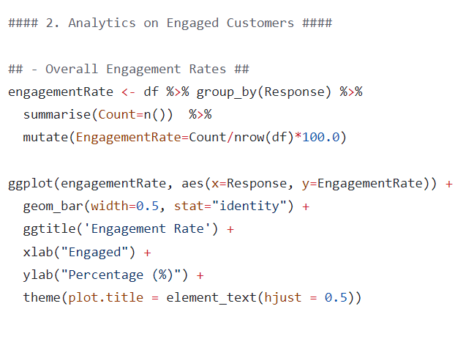
Conducting customer analytics with R

Slide 44
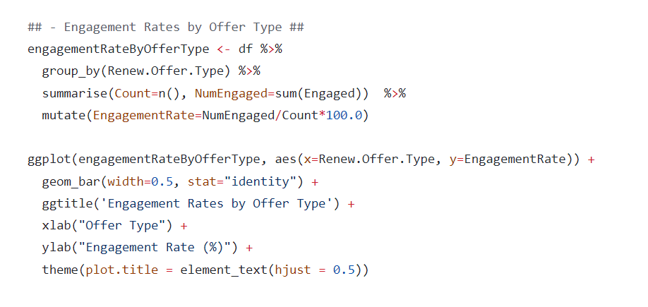
Conducting customer analytics with R

Slide 45
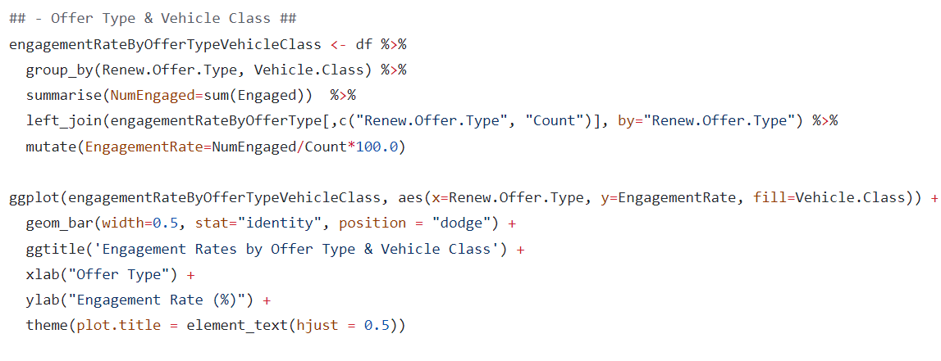
Conducting customer analytics with R

Slide 46
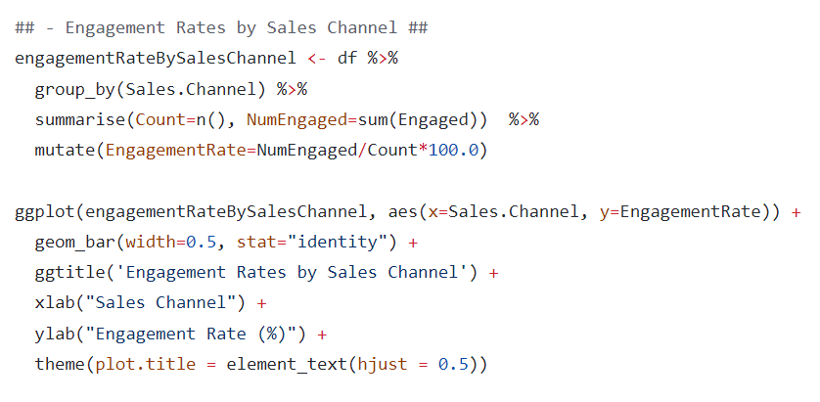
Conducting customer analytics with R

Slide 47
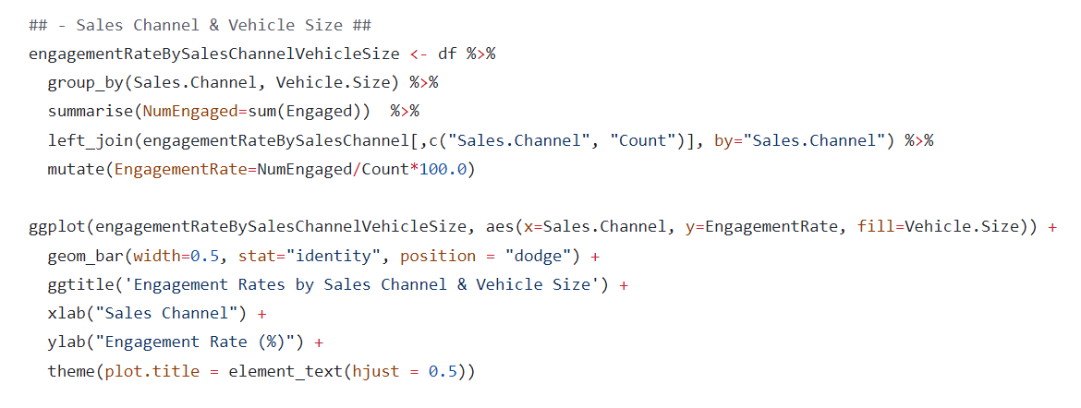
Conducting customer analytics with R

Slide 48
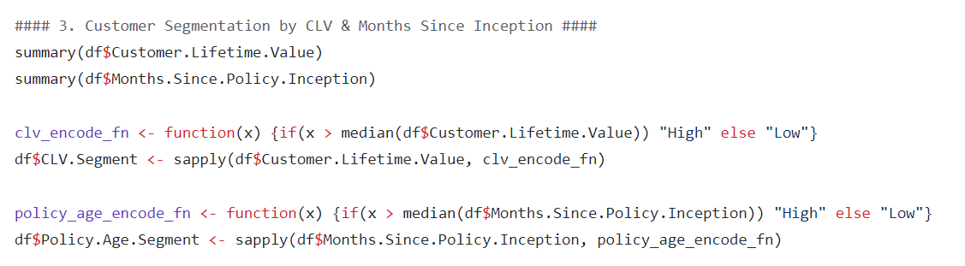
Conducting customer analytics with R

Slide 49
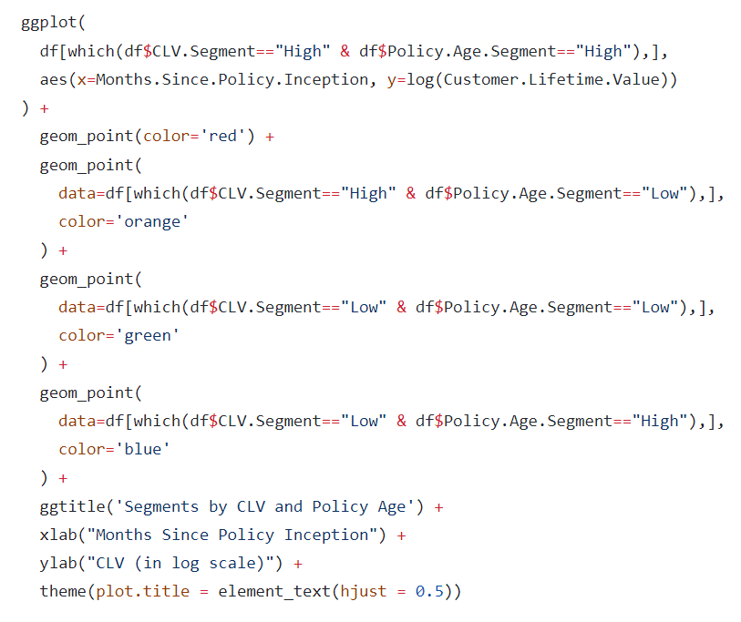
Conducting customer analytics with R

Slide 50
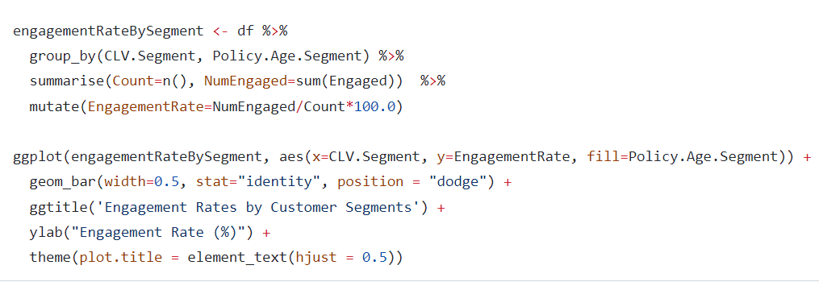
Conducting customer analytics with R

